Slide 1
Final Capstone case study for Google data analytics professional certificate by
- Ghadge Saurabh

Slide 2

Case Study:
How Does a Bike-Share Navigate Speedy Success?
By Saurabh ghadge

Slide 3
Gentlemen why are we here?..
How do annual members and casual riders use Cyclistic bikes differently?
Why would casual riders buy Cyclistic annual memberships?
How can Cyclistic use digital media to influence casual riders to become members?
Notes:
In this presentation I am going to answer the first question.

Slide 4
About data
We used Cyclistic’s historical trip data to analyze and identify trends, which can be found here.
The data has been made available by Motivate International Inc. under this
license

Slide 5
Lets start pedalling….
How do annual members and casual riders use Cyclistic bikes differently?

Slide 6
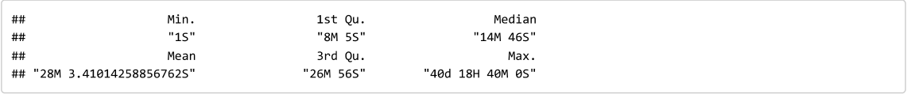
Summary of ride length
Notes:
This is basic summary of column ride_length, From which we observe that minimum ride length is of only 1 seconds while the maximum ride_length is of 40 days,18 hour and 40 minutes long. The overall mean of ride_length is 28 Minutes.

Slide 7
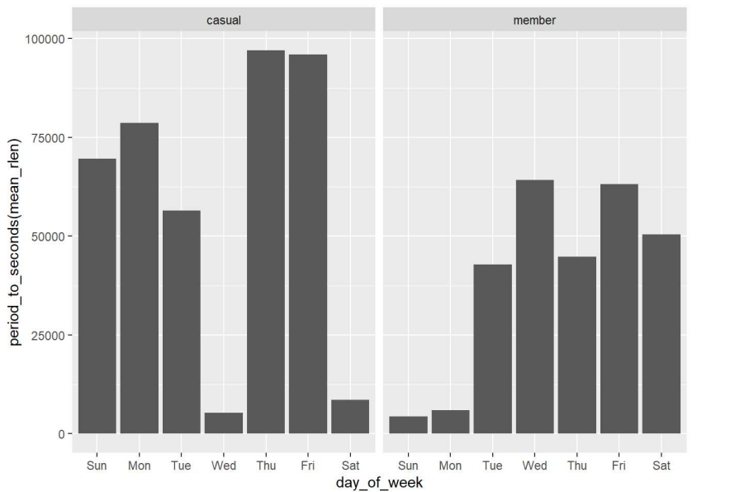
Average ride length against week day for given rider(casual/member)
Notes:
We see that average ride_length for casual riders is longer than that of member riders. Also Casual riders are tends to have more average ride_length on Thursday and Friday while member riders on Wednesday and Friday.

Slide 8
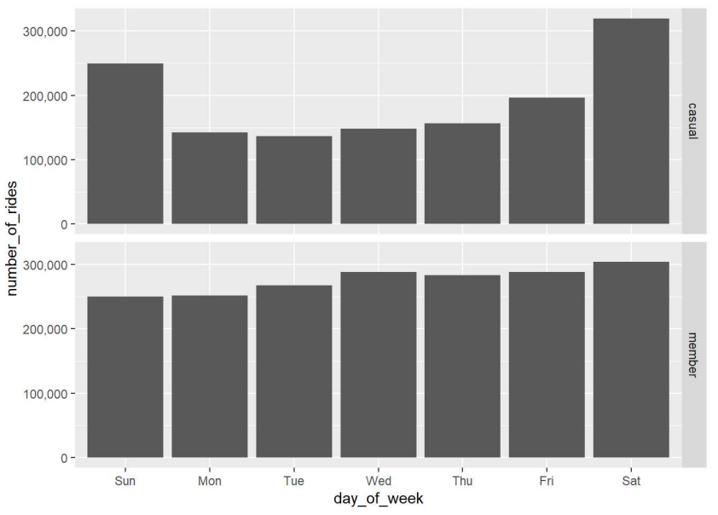
Number of rides at given day for given rider
Notes:
For casual riders number of rides is far less as compared to member riders. Next we are going to check for monthwise number of rides for both type of risers.

Slide 9
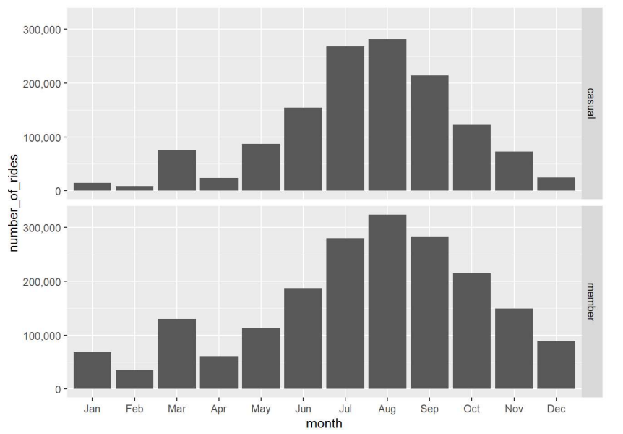
Number of rides by month for a given rider
Notes:
We see that for both riders number of rides from April month are start to increases, for August number of rides are higher among all months and then it starts to fall down.
Now we will try to find out relation between start_station and member_casual riders..

Slide 10
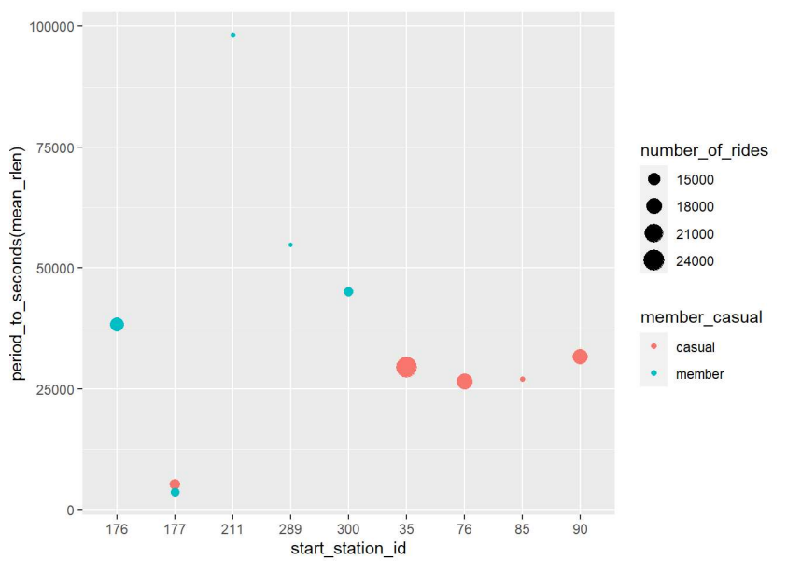
Number of rides by start station
Notes:
From this plot now we can visually clarify that at station 35 most of rides were happened and they are by casual members.Also at station 177 number of rides for both riders are constant.It seems that member riders ride length is pretty much higher than casual riders.
Similarly, we can check at which station most of the rides were ended and by which types of riders(member/Casual).

Slide 11
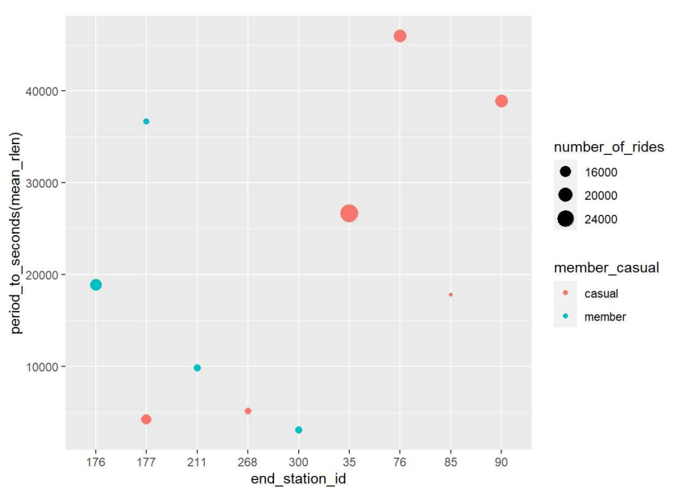
Number of rides by end station
Notes:
At station 35 most of casual riders rides were ended and also their ride length is also seems to be maximum than member riders, which is completely different from start_station_id where ride_length of member riders were seen to be maximum, also lots of member riders ended their rides at station 176.

Slide 12
conclusions
For both member and casual riders shows same average ride length.
Average ride length for casual riders is longer than that of member riders. Also Casual riders are tends to have more average ride length on Thursday and Friday while member riders on Wednesday and Friday.
For casual riders month wise average ride length is higher than member riders and also both shows slightly decrease in ride length over month.
…..continued

Slide 13
casual riders number of rides is far less as compared to member riders.
For both riders number of rides from April month are start to increases, for August number of rides are higher among all months and then it starts to fall down.
At station 35 most of casual riders rides were ended and also their ride length is also seems to be maximum than member riders, which is completely different from start_station_id where ride length of member riders were seen to be maximum, also lots of member riders ended their rides at station 176.

Slide 14
Hope this bicycle ride is exercising and freshening for you…
Thank you…

